Slide 1
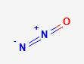

Nitrous oxide (N₂0) emission
Zhenqi Luo 2020.10

Slide 2
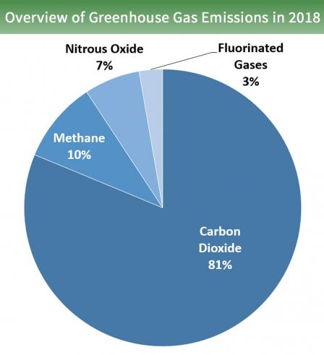
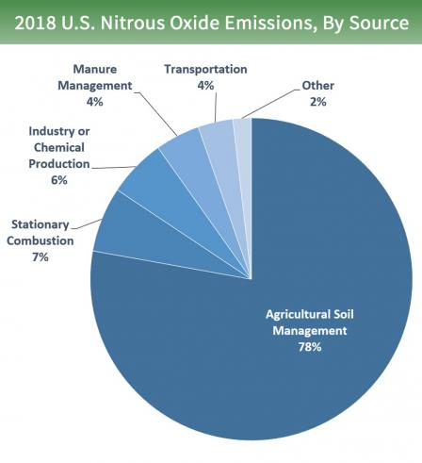
a long-lived greenhouse gas
an extremely potent greenhouse gas:
Lifetime in Atmosphere: 114 years
Global Warming Potential (100-year): 298 (IPCC, 2007)
sources:
Agriculture (US: 78%, Global: ~22%):
Soil management: fertilizer and crop
Manure management
Agricultural burning
Fuel Combustion
Industry: byproduct (e.g. production of nitric acid)
Waste: during nitrification and denitrification of the nitrogen present
Natural: bacteria breaking down nitrogen in soils and the oceans
(EPA)
Notes:
Contribution of Working Group I to the Fourth Assessment Report of the Intergovernmental Panel on Climate Change. [S. Solomon, D. Qin, M. Manning, Z. Chen, M. Marquis, K.B. Averyt, M. Tignor and H.L. Miller (eds.)]. Cambridge University Press. Cambridge, United Kingdom 996 pp.
The Global Warming Potential (GWP) was developed to allow comparisons of the global warming impacts of different gases. Specifically, it is a measure of how much energy the emissions of 1 ton of a gas will absorb over a given period of time, relative to the emissions of 1 ton of carbon dioxide (CO₂).

Slide 3

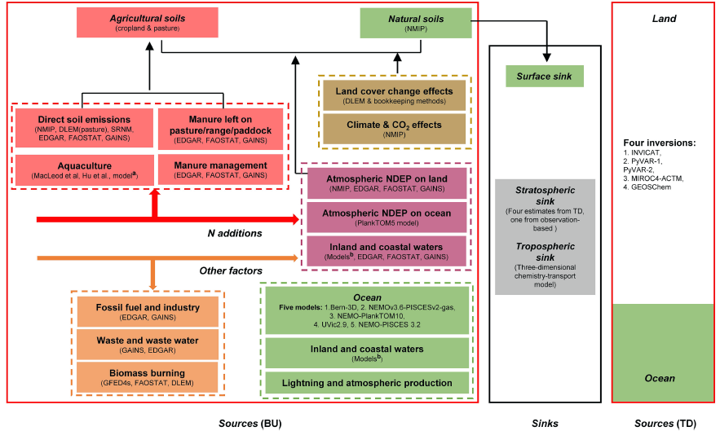
global nitrous oxide sources
Simple introduction
A reconciling framework: constructed 43 flux estimates:
30 bottom-up (BU)
emission inventories
spatial extrapolation of field
flux measurements
nutrient budget modelling
process-based modelling
5 top-down (TD)
measurements
inversions
8 observation and modelling
(Tian et al., 2020)
Notes:
https://doi.org/10.1038/s41586-020-2780-0
The methodology for data synthesis of the global N2O budget

Slide 4
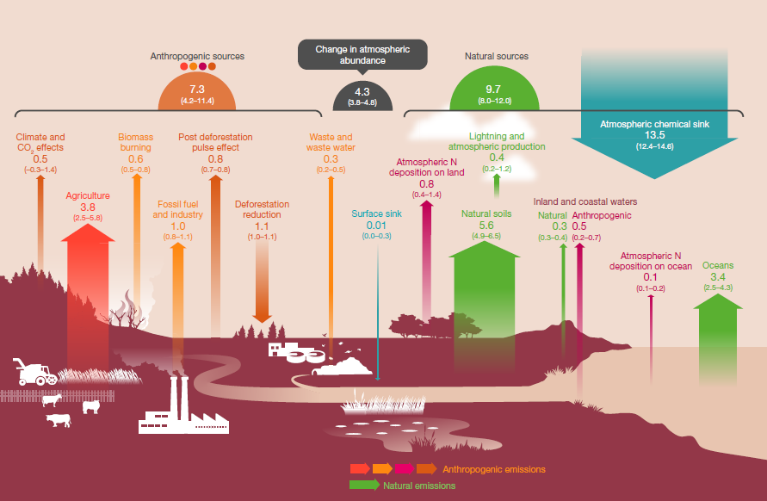
global nitrous oxide sources
The global N2O budget (2007–2016)
Natural sources (57%)
Natural soils (33%)
Lightning and atmospheric production (2%)
Waters (2%)
Oceans (20%)
perturbed fluxes from ecosystems (3%)
Climate change
CO2 effect
land cover change
agricultural sector (22%)
other direct anthropogenic sources (12%)
fossil fuel and industry (6%)
waste and waste water (2%)
biomass burning (4%)
indirect emissions from ecosystems (6%)
transport (5%)
deposition (1%)
(Tian et al., 2020)
Notes:
https://doi.org/10.1038/s41586-020-2780-0
red, direct emissions from
nitrogen additions in the agricultural sector (agriculture); orange, emissions from other direct anthropogenic sources; maroon, indirect emissions from anthropogenic nitrogen additions; brown, perturbed fluxes from changes in climate, CO2 or land cover; green, emissions from natural sources

Slide 5
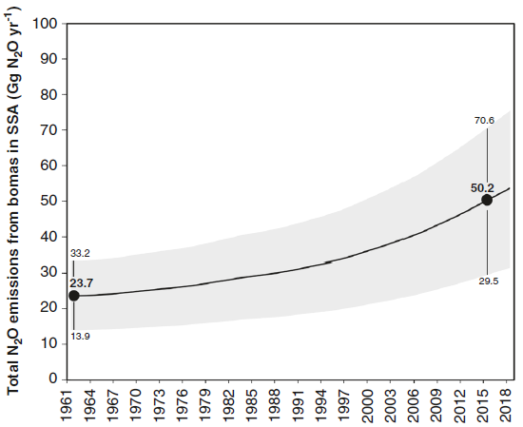
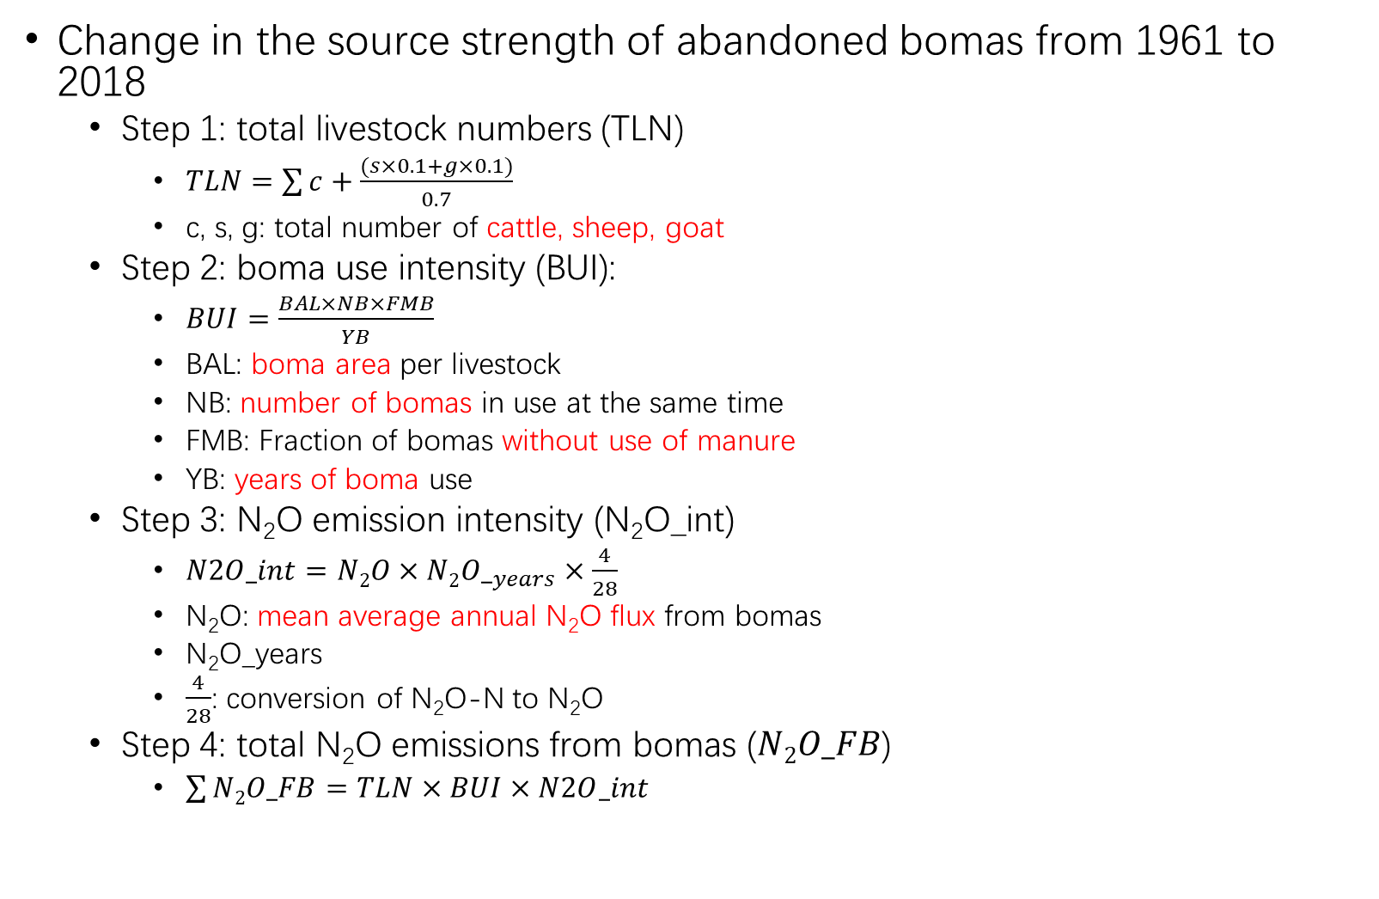
N₂O emissions from bomas in drylands of Sub-Saharan Africa (SSA)
Change in the source strength of abandoned bomas from 1961 to 2018
Step 1: total livestock numbers (TLN)
$TLN=\sum{c}+\frac{(s×0.1+g×0.1)}{0.7}$
c, s, g: total number of cattle, sheep, goat
Step 2: boma use intensity (BUI):
$BUI=\frac{BAL×NB×FMB}{YB}$
BAL: boma area per livestock
NB: number of bomas in use at the same time
FMB: Fraction of bomas without use of manure
YB: years of boma use
Step 3: N₂O emission intensity (N₂O_int)
$N2O_int=N2O×N2{O_}_{years}×\frac{4}{28}$
N₂O: mean average annual N₂O flux from bomas
N₂O_years
$\frac{4}{28}$: conversion of N₂O-N to N₂O
Step 4: total N₂O emissions from bomas ($N2O_FB$)
$\sum{N2O_FB}=TLN×BUI×N2O_int$
(Butterbach-Bahl et al., 2020)
Notes:
https://doi.org/10.1038/s41467-020-18359-y | www.nature.com/naturecommunications

Slide 6
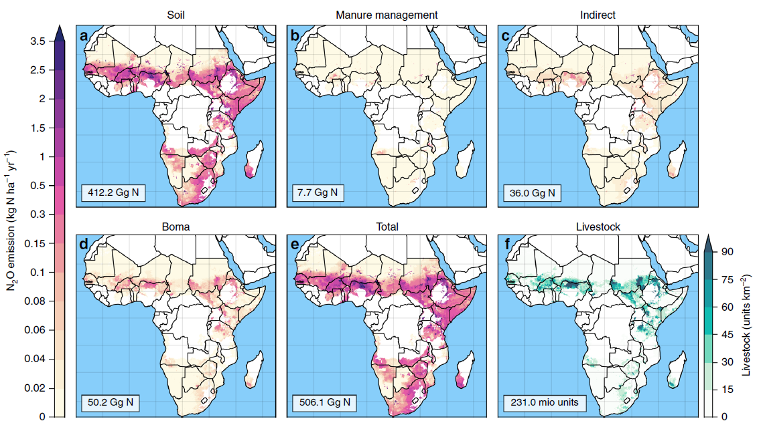
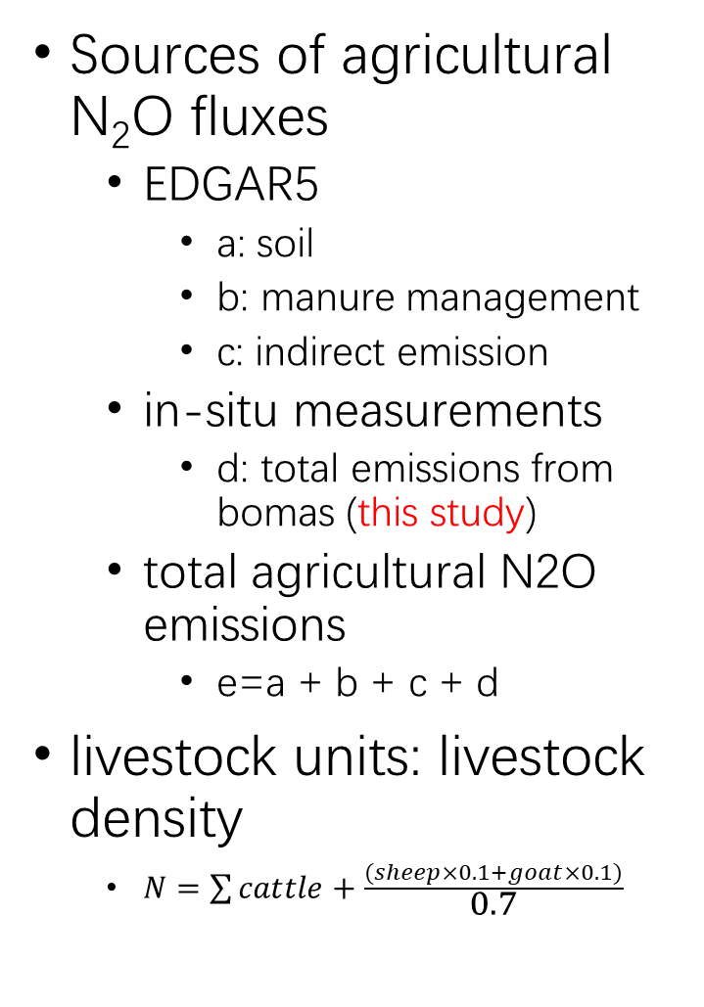
N₂O emissions from bomas in drylands of Sub-Saharan Africa (SSA)
Sources of agricultural N₂O fluxes
EDGAR5
a: soil
b: manure management
c: indirect emission
in-situ measurements
d: total emissions from bomas (this study)
total agricultural N2O emissions
e=a + b + c + d
livestock units: livestock density
$N=\sum{cattle}+\frac{(sheep×0.1+goat×0.1)}{0.7}$
(Butterbach-Bahl et al., 2020)
Notes:
https://doi.org/10.1038/s41467-020-18359-y | www.nature.com/naturecommunications

Slide 7
Questions?

